Slide 1
SECURITY CHALLENGES IN SMART CONTRACTS
Lucas pelloni
Ile cepilov
Notes:
ILE
Hi every one.
Today we are going to tell you about Smart Contracts and their security challanges.

Slide 2
Content
Blockchain
What is a Blockchain?
How does it work?
Smart Contracts Introduction
What is a Smart Contract?
Scenario Example
Traditional Contracts vs. Smart Contracts
Possible applications
Ethereum, Blockchain-based Platform
Notes:
ILE

Slide 3
Content
Security Challenges in Smart Contract
Dao Attack
King of the Ether Throne Attack
Multi-Player Game Attack
Rubixi Attack
Govern-Mental Attack
Questions
Discussion
Notes:
ILE

Slide 4
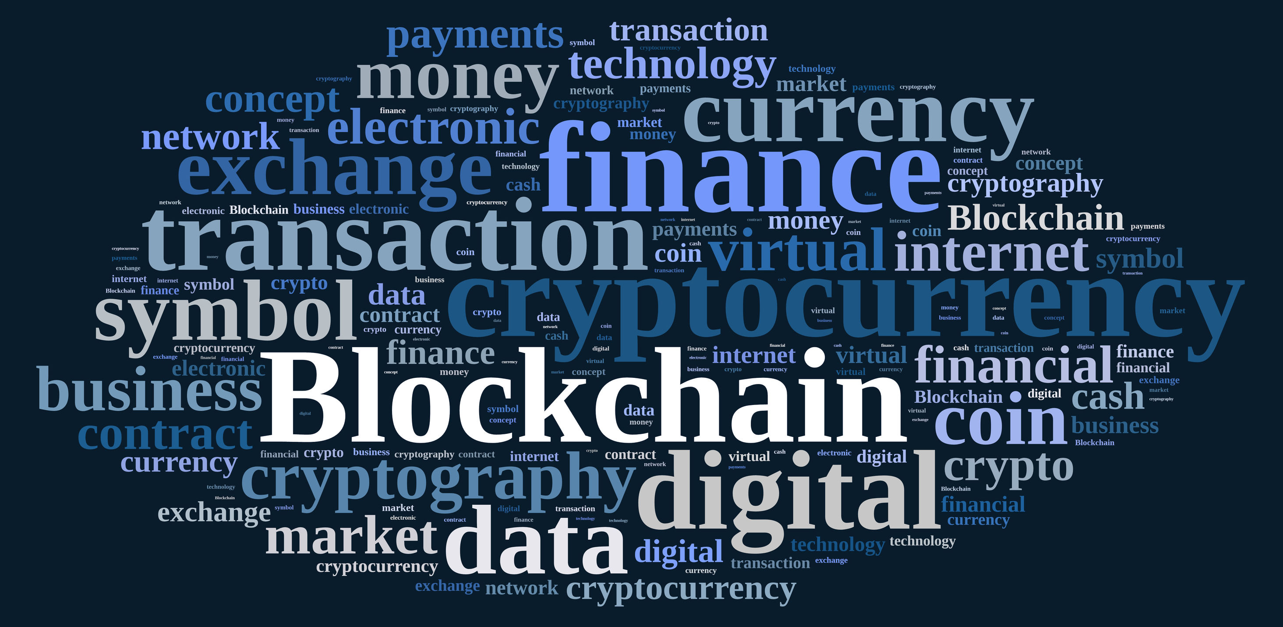
2.1 What is a blockchain AND HOW DOES IT WORK?
Distributed Database
Public digital ledger
Source of Trust
Notes:
ILE
DISTRIBUTED DB
You can see BLOCKCHAIN as an open distributed database which keeps track of every transaction involving values and maintained by the nodes of a P2P network (miners) (Money, goods, property word or even votes)
Thanks to the decentralized database, there is no longer the need of a thirty part trust organisation
PUBLIC LEDGER
Every transaction will be recorded on a public and distributed ledger
YOU CAN SEE THIS DATABSE AS A PL accessible to everybody
SOURCE OF TRUST
Blockchain will become a global decentralised source of trust
Because nowadays, , most people use a trusted middleman such as a bank to make a transaction which makes it easier to attack, whereas the blockchain allows consumers and supplier to connect directly

Slide 5

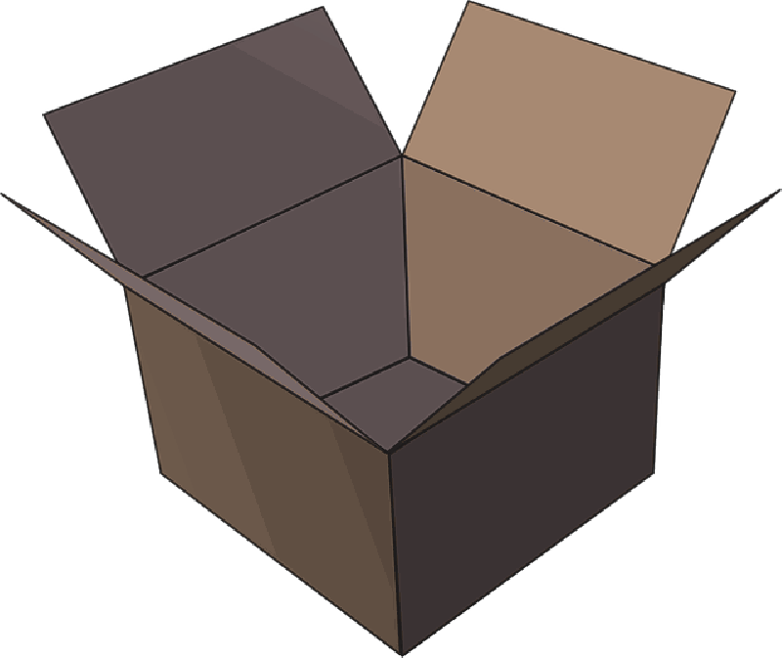
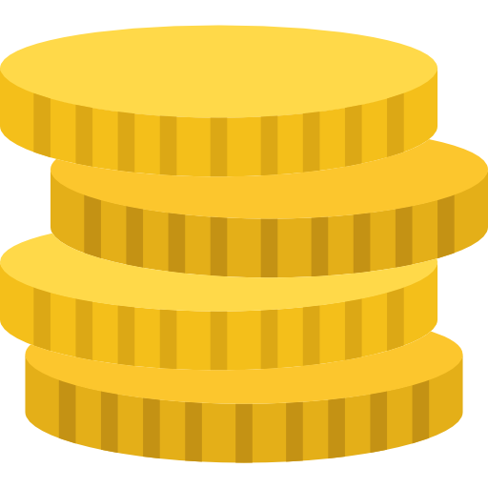


2.2 How does blockchain work?
Notes:
_LUCAS
So to make it easier to understand, we will give you an example.
So let's say alice wants to buy a product from bob’s store.
Recently (RICENTLY) bob's store introduced crypovalues (for example bitcoins) as a payment method.
Alice has some bitcoins to spend and she wants to buy a product using them.
The transaction can be represented online as a ‘block’

Slide 6





2.2 How does blockchain work?
Notes:
The block (resp. the transaction) is broadcast across the entire network.
In order to complete the transaction, the miners (the nodes) have to validate it.

Slide 7


2.2 How does blockchain work?
Notes:
Once validated, the block is added to the blockchain, which records the entire NON-reversible history of transaction in a public ledger
after the validation process the money moves from Alice to Bob
--------------------------------------------------------------------------
Let's talk about the main applications of blockchain technology
APPLICATION BLOCKCHAIN
One of the most famous blockchain application is the transfer of bitcoins used for online trades.
2. Cloud storage distributed systems across the network (like StroJ) where each file is shredded and encrypted and distributed
3.

Slide 8
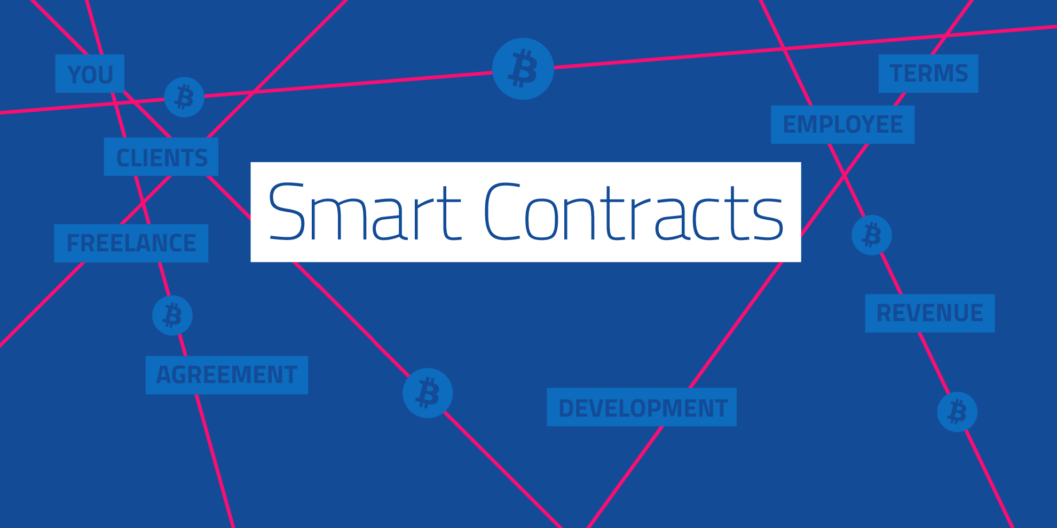
Notes:
Think of it as wills and contract that execute themselves

Slide 9
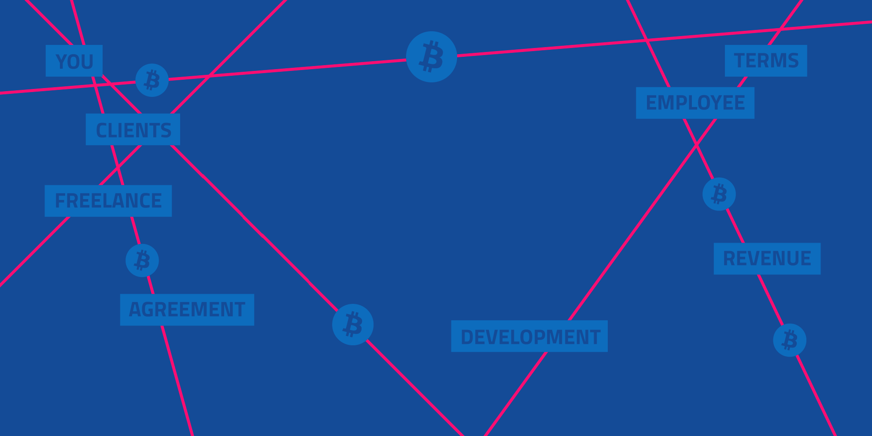
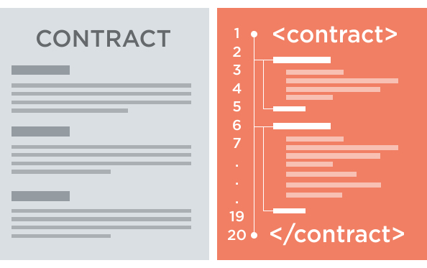
3.1 What is a smart contracT?
A smart contract is a piece of software that defines the rules of an agreement
It automatically verifies itself and executes the terms contained inside it
Stored on the Blockchain
Notes:
A SC is a piece of software or a program that stores rules for negotiating the terms of a contract, it automatically verifies the contract and then executes the agreed terms
Encrypted and Stored on the blockchain, which means that an external trusted authority is not needed and if any party fails the system continues to functions with no loss of data or integrity
To append a new block of data (the code for the execution of a SC) to the blockchain, the miners have to validate the exectuion of the SC

Slide 10
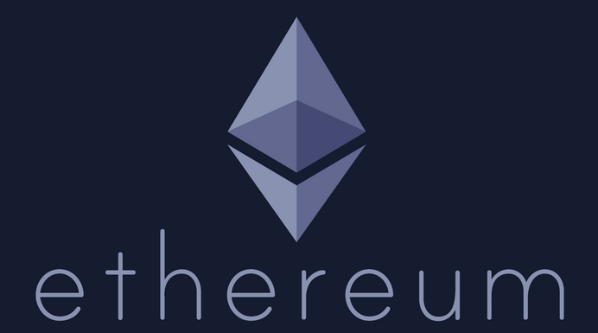
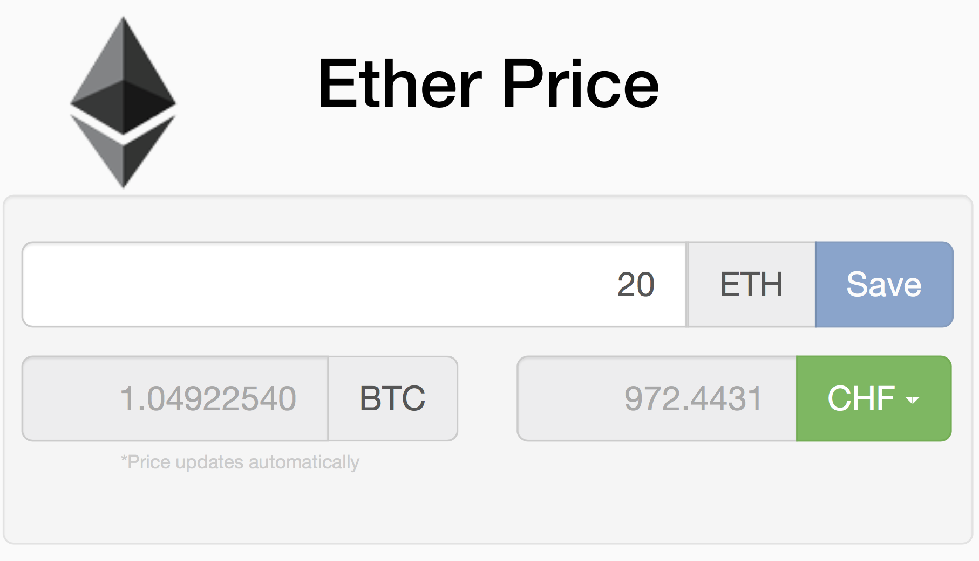
3.2 Ethereum, Blockchain-based Platform
Decentralized platform that runs smart contracts
Custom built Blockchain
Ether
Solidity (high) & EVM (low)
Notes:
Ethereum is a decentralized platform that runs smart contracts exactly as programmed wihout any possibility of downtime, fraud or third party interference
The SCs run on a custom built blockchain, which is not the same used for BITCOINS transactions
The cryptovalue used in Ethereum is not Bitcoins but it is ETHER,which is used as a payment method for executing contracts
-->IMMAGINEEEEEEEEE
The code of an Ethereum contract is written in Solidity, which is a high level language that looks like JavaScript. It is compiled on the Ethereum virtual machine.

Slide 11
3.3 SMART CONTRACT’S properties IN ETHEREUM
Contract address
Balance
Fallback function()
Variable msg (amount, data)
Gas system
Gas limit
Gas price
Notes:
And now let's have a look at the main properities of a SC in ethereum.
It is identified by a contract address;
It has a balance which holds the amount of virtual coins (ether)
It always has a Fallbackfunction which is obviously a function but with no parameters and no name:
Any transaction invoking a contract will execute the fallback function by default.
The informations of the sender, the amount of Ether sent to the contract and the included data of the transaction are stored in a variable called msg.
Then there is the Gas system , which is there
To ensure fair compensation for the computational effort.
When a user sends a transaction to invoke a contract, he has to specify how much gas he is willing to provide for the execution (called gasLimit) as well as the price for each gas unit (called gasPrice) .
--------
Example:
You can imagine the GasLimits: as the amount in liter of gasoline (10Liters)
GasPrice: price for each liter of gasoline
→If the amount is too much or the price for each liter is too high, the execution is terminated with an exception → state is reverted as it nothing happened BUT the gasLImit has to be paid as a counter measure against resource-exhaustion attacks
On Ethereum, miners are free to ignore transactions whose gas price limit is too low.

Slide 12
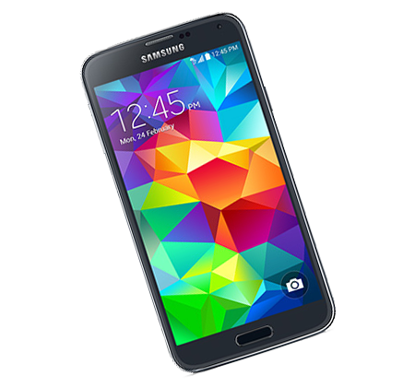
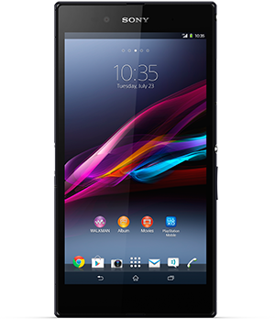
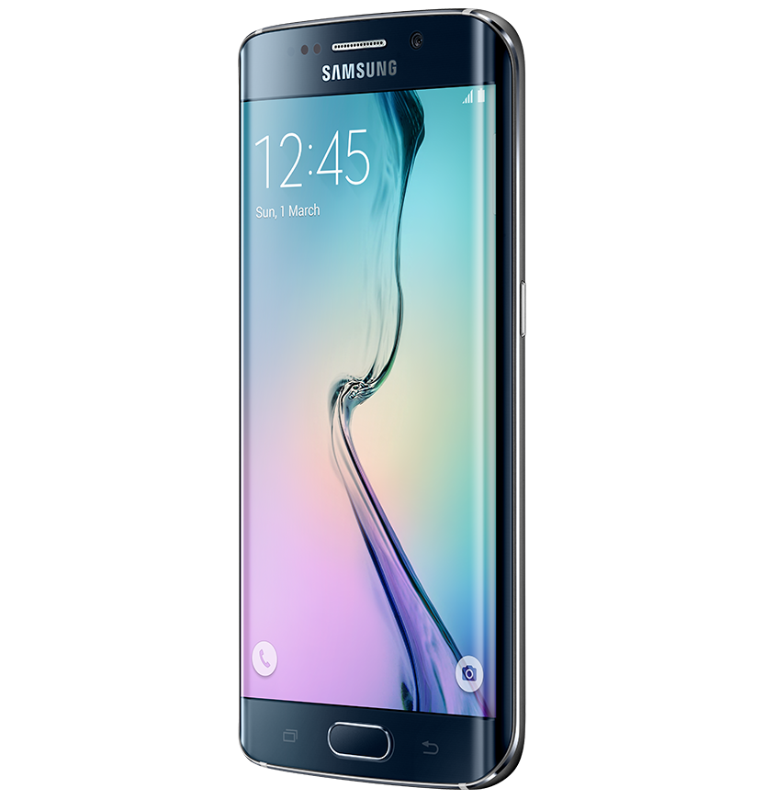
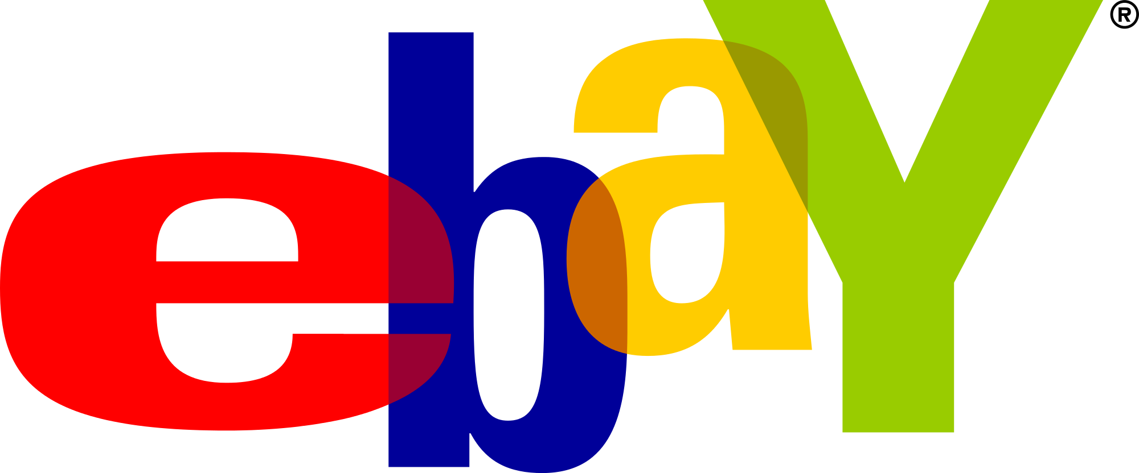
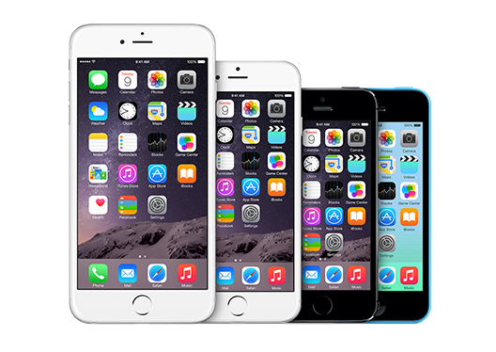
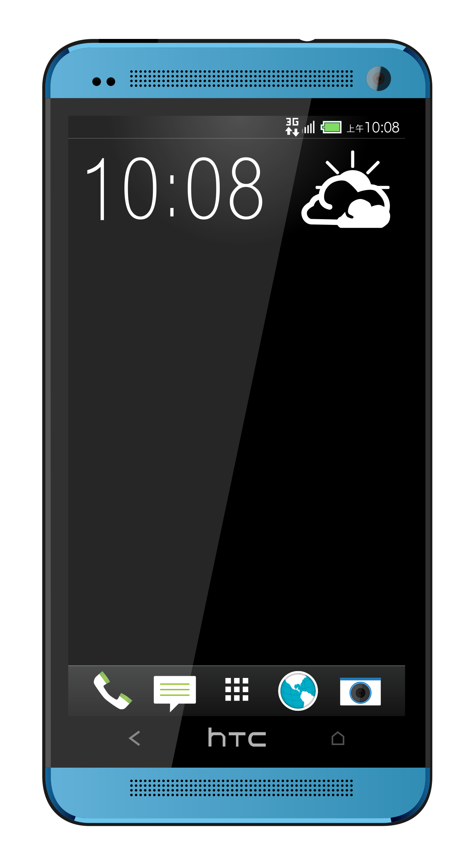
3.4 Scenario Example
Notes:
Let's consider another scenario example.
An online payment without involving a smart contract.
Like before
1. Alice wants to buy a SmartPhone on Ebay.
She is willing to pay a certain amount of money for it.
This time we are not going to talk about bitcoins, instead we are going to focus on the payment process.
Alice chooses a smart phone (a samsung:))

Slide 13
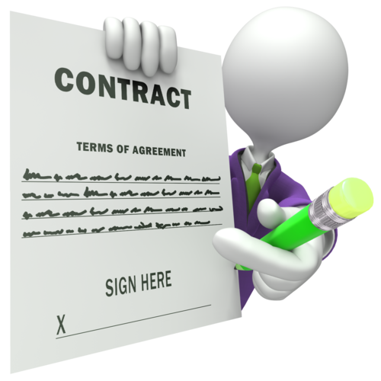
3.4 Scenario Example
Notes:
For buying the smart phone, alice wants to make sure that she would get the product she is paying for. Therefore, she stipulates a TRADITIONAL contract with Bob, an Ebay employee who works in the legal area.
On the tradictional contract there are the following agreements:
The Phone will be shipped to Alice only once the money transaction has been confirmed.
The middleman Bob, is in charge of checking whether the payment has really been made.
If not, he waits 1-2 days and then he checks the payment again.

Slide 14

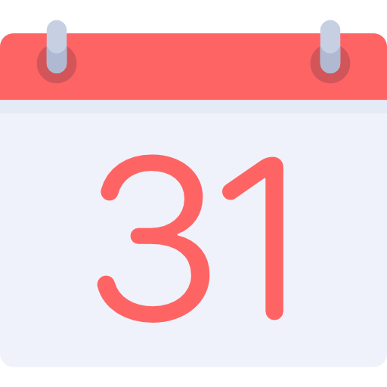

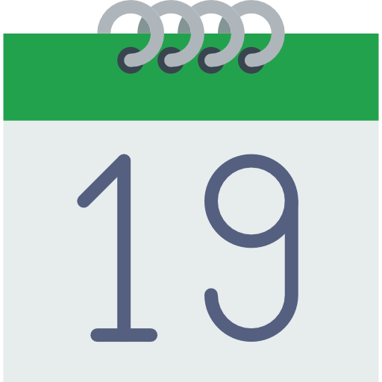


3.4 Scenario Example
I will check
it again in
2 days..
Where is
my phone?
Notes:
A better explanation of the contract terms
Alice pays for her Smartphone on a certain day (the end of the month)
Bob, doesn’t know when Alice actually paid for her Smartphone. Therefore he checks the payment once in a while.
The first time that bob checks the payment, the money is not arrived yet (even though alice already paid for her product)
Bob not seeing (SIIIIIIIING) the money and according to the contract terms, waits another two days for checking the payment again
In the meantime, alice is getting angrier (ENGRIER)
The money transfer is finally completed but bob, who had just checked, waits another two days
After two days bob checks the payment again, and he notes that the money has been successfully transfered
After that, the product is ready to be shipped
In total, alice waitet almoust three weeks to get her smartphone
As you can see, Alice is not happy with this kind of deal. A traditional contract needs always a middleman, who checks and executes the agreed terms defined in the contract.
This process implies (IMPLAIS) always a delay between seller and buyers and implies also some costs for the company (the middleman has to be paid for his work).
A lawyer (LOYER) might be necessary if some party doesn’t comply with the contract.

Slide 15



3.4 Scenario Example
I could use
a Smart Contract!
Notes:
Alice got an idea! She could use a smart contract to make the process faster and better.
Let’s suppose that Ebay works together with a company which provides some services for Smart Contracts (e.g. Ethereum).
Alice wants to try this new service and stipulates a new SM with Ebay.

Slide 16
3.4 Scenario Example
Notes:
As soon as Alice makes the payment, the SC is triggered and when the payment is confirmed, Ebay will be notified by the SC and can immediately (IMMIDIATELY) send the smart phone.
As you can see: the process is istanteneous and there is NO need of a middleman

Slide 17
3.4 Scenario Example
Notes:
Just follow alice and choose a smart contract!
if you don't want to get angry

Slide 18
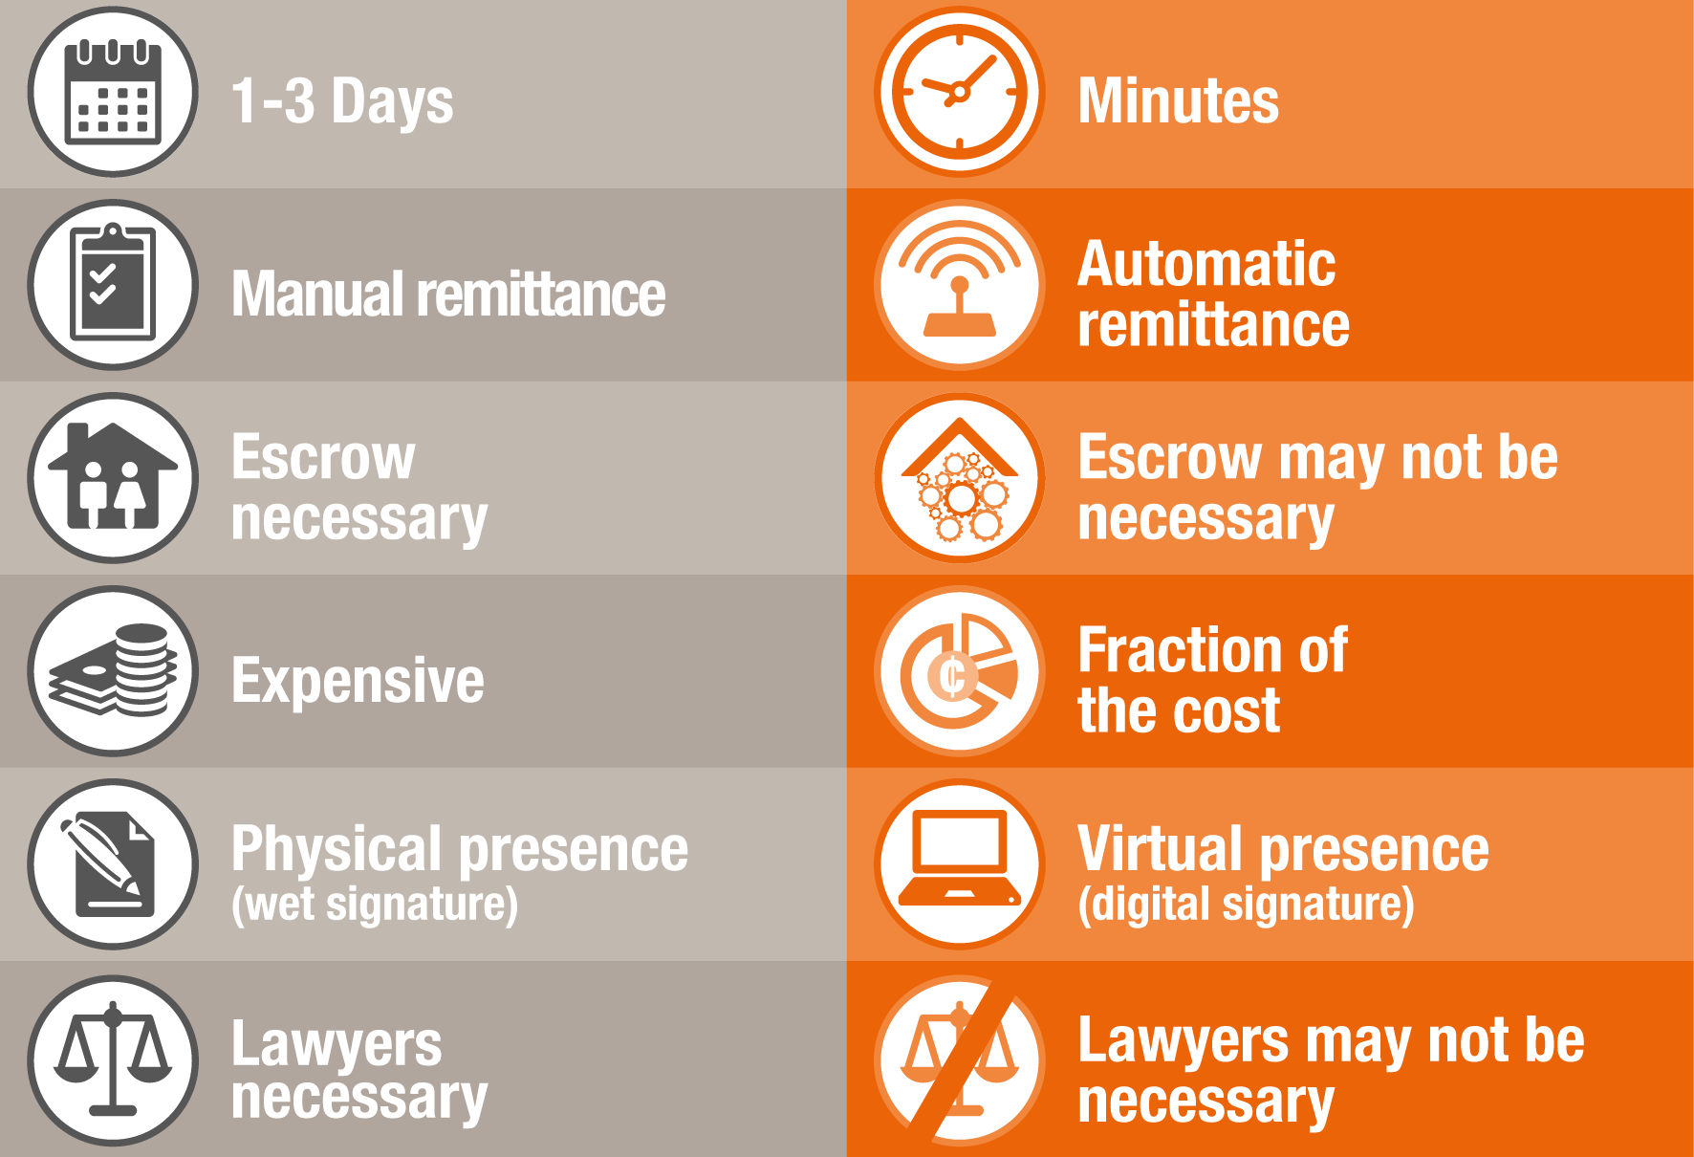
3.5 Traditional ContractS vs. Smart Contracts
TRADITIONAL
SMART
Notes:
The following table shows the main differences between traditional and smart contract:
1. As shown in the example, a smart contract is faster than a traditional one, which means that it can be executed faster
2. The payment process can be executed automatically
3. A Smart Contract is for sure cheaper than a traditional one. You don’t have to pay for a middleman who checks the agreements, you have only to pay the ”code”.
4. A Smart Contract cannot get lost and its always available in chronological order on the blockchain for future access
Like said before, there is no need of a middleman (lawyer)

Slide 19
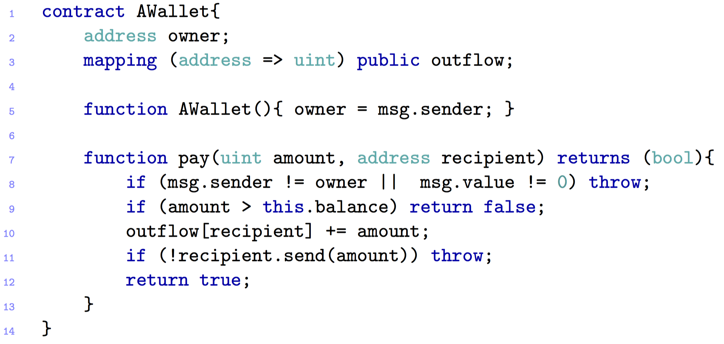
3.6 A simple WALLET CONTRACT
Notes:
Let's have a look at a simple wallet contract.
What goes INTO A SMART CONTRACT?
This snippet implements a personal wallet associated to an owner.
Line 5: Constructor, where the wallet gets associated to its owner
Line 7: Pay function which takes as parameters an amount of cryptovalue and the address of who is going to receive (RESIV) the money
Line 8: Exception that gets thrown if the caller is not the owner (the owner is the only one that can logically send his money)
Line 9: the Call returns false if there is not enough amount on the wallet
Line 10: The outflow registry (blockchain) gets updated before the ether is transferred to the receiver (RESIVER).
Line 11: If the recipient is a contract return false, otherwise return true

Slide 20
3.7 Possible Applications
Financial services
Coupon payments
Loans (e.g. Leasing)
Life sciences
Electronic medical records
Cross-Industry
Voting
Notes:
LET’S HAVE A LOOK AT THE POSSIBLE SMART CONTRACT APPLICATIONS
FAINANSHAL SERVICIES
Coupon payments: Automatically calculates and pays coupon for each period (PIRIOD) (for bonds)
Leasings: A SM could be stored into blockchain, togheter with some ownership informations. If the borrower misses a payment, the SC should automatically revoke (RIIVOOKE) the digital keys or whatever.
(esempio automobile hardware motore)
Voting system: The votes criteria can be stored into a smart contract

Slide 21

ATTACKS AND
SECURITY CHALLENGES
IN SMART CONTRACT

Slide 22

4.2 MOST FAMOUS ATTACKS – The DAO ATTACK 1
Crowd-funding platform
Attacker managed to put over $60 M
Notes:
One of the most famous attack on Smart Contracts was the Dao Attack( Decentralised Autonomous Organisation)
It was a crowd-funding project BUT a hacker found a a security flow in its code
On June 17° the hacker managed to steal 3.6 Milion Ether and put them into a personal Account
The value of the Ether currency DRASTICALLY DROPPED from 20.5 dollars to 11.20 dollars

Slide 23
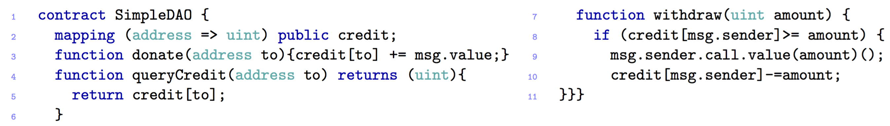
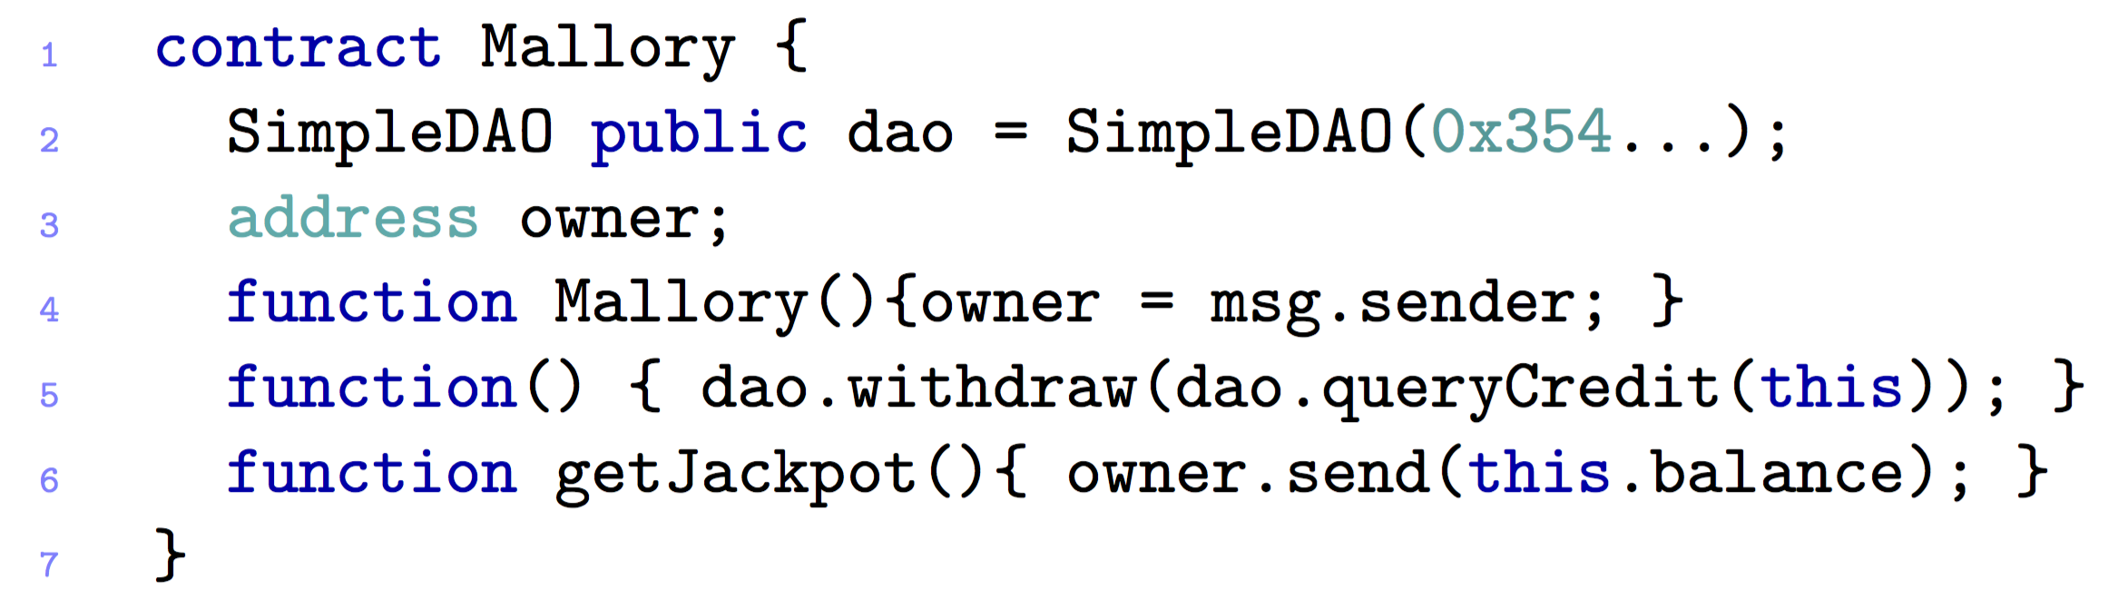
4.2 MOST FAMOUS ATTACKS – The DAO ATTACK – #1
Notes:
Consider this SimpleDAO Contract
The Attack which we want to present you allows the hacker to steal all the ether from the SimpleDAO:
It works as follows:
Publish a Mallory Contract (like this one) CLICCARE
The Hacker donates some ether for Mallory and invokes the Mallory Fallback (Line 5.)
A Fallback is just a function without any name or parameter which will called by default if some ether is sent to the contract without providing any data
The Fallback inkoves the function withdraw of the SIMPLE DAO CONTRACT which transfers the ether to Mallory
The Function call inkoves the fallback of Mallory again (msg.sender.call.value(amount))
The fallback invokes again the withdraw and so on UNTIL ONE OF THE FOLLOWIN CONDITION IS SATISFIED
NOTE: LINE 10 will never be updated until:
The gas is exhausted (gas = is a fee paid to the miners proportinal to their power computation)
Call Stack is full
Balance of DAO becomes 0
THIS IS REQUIRE BECAUSE THE LINE 10 does not have to be executed in order to keep the money on the contract

Slide 24
4.2 MOST FAMOUS ATTACKS – The DAO ATTACK 1 – POSSIBLE SOLUTIONS
There are only ways to suppress the attack:
Soft-Fork
Intention: Freeze attacker’s transaction
Miner Majority must accept it
Hard-Fork
Return all the Ether taken from the DAO to a refund Smart Contract
Only one function: “withdraw”
Approved by the community on the 19th July
Completed on the 20th July
Notes:
It's unlikely The DAO will ever recover from the attack. However the Ethereum network and blockchain technology in general can learn from their errors and prevent future attacks
The community had two choices to suppress the attack
the first one was a a Soft fork where the intention was to freeze the attacker’s transaction
But there were some problems with it. First of all the majority of miners must accept it and second of all, the blocks containing a transaction that helps the attacker move the Dark DAO funds will be ignored. Moreover this soft work would have introduced a potential DOS attack
The second choice was a Hard fork, which meant returnin all the ether taken from the Atttack and put it into a refund Smart Contract where the victims could withdraw their stole funds
This solution was approved by the communiti on the 19° of july and was completed the day after./
Vitalik Buterin, co-founder of Ethereum, explained at a conference on 27 July 2016, that also a secondary hard-fork would have been necessary \cite{vit}. In fact, he announced the following: \\ \textit{"We also encourage the ETC community to consider adopting a secondary hard fork to change transaction formats to make further replay attacks impossible."}

Slide 25
4.2 MOST FAMOUS ATTACKS – KING OF THE ETHER THRONE
Game’s goal: become the “King of Ether”
You have to pay the current king and a small fee to the contract
Prize increases each time
Notes:
Let's have a look at a small game: the king of the ether throne
The game’s goal is to become the king of Ether.
In order to do that, you have to pay an amount greater than the claimprice (the current price of the game). If the amount is greater, you become the king and a small fee has to be paid to the old king.
The prize of course increases each time

Slide 26
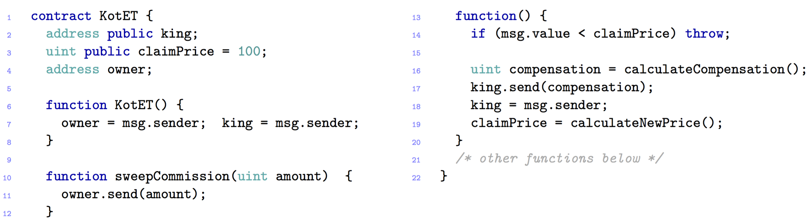
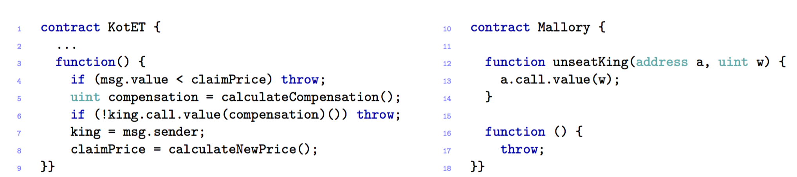
4.2 MOST FAMOUS ATTACKS – KING OF THE ETHER THRONE
Notes:
Let’s have a look at how it really works
A Player (a potential King) sends some Ether to the contract
(CLICK)The function fallback is invoked
(CLICKThe fallback checks if the sent value is enough to buy the title (if not it throws an exception, which means that the the transfer is reverted)
(CLICK)If the amount is enough, the Compensation is computed and sent to the old king and the new player is accepted as the new king
The Difference between msg.value and the compensation is kept (KEPT) by the contract
(CLICK) The Owner of this contract can withdraw the ether accumulated (via sweepCommission)
There could be a problem with this contract:
There is no checking in the return code of the function SEND -> this may result in lost of ether.
For example: if there would be someone who wants to attack this contract, he could require much more gas for the send Compensation function (which means, that his fallback function would be very expensive)
Indoing so, the function call at line 17 fails and since there is no check in the return code, the compensation for the old king remains into the contract, even though a new king will be set (in this case the attacker)
The attacker can easily withdraw the compensation
----------------------------
Let's consider a second attack for this contract
Consider an attacker Mallory, whose fallback just throws an exception. (CLICK( The hacker calls unseatKing with the right amount of ether, so that Mallory becomes the new king.
At this point, nobody else can get her crown, since every time KotET tries to send the compensation to Mallory, her fallback throws an exception, preventing the coronation to succeed.

Slide 27
4.2 MOST FAMOUS ATTACKS – King Of the ether – POSSIBLE SOLUTIONS
Failed compensation sends
Include more gas with each payment
Exception disorder
Handle exceptions in a uniformly way
Notes:
https://www.kingoftheether.com/contract-safety-checklist.html
POSSIBLE SOLUTIONS TO CHECK THE KING.SEND
Including a reasonable amount of gas with each payment sent (you give enough gas to make the transaction possible) OR
If there is a too expensive fallback function, the payment throws an exception
.
-----------------------------------------
If an exception is thrown the whole transaction has to be reverted and not only the state between the two function calls.

Slide 28
4.2 MOST FAMOUS ATTACKS – Multi-player games
Game: odds and evens
Each player chooses a number
Sum is even or odd
Notes:
And now consider a contract that implements a simple Odds and Evens game between two players. Each player chooses a number, if the sum of the two numbers is even --> the first player wins otherwise the secondo one wins

Slide 29
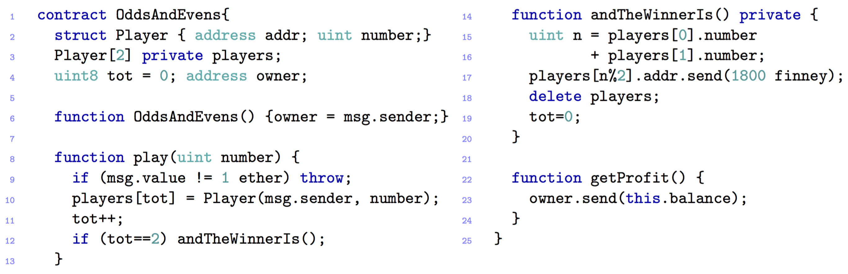
4.2 MOST FAMOUS ATTACKS – Multi-player games
Notes:
The contract works as follows:
The contract records the bets of two players in the field players (line2) Since this field is private, other contracts cannot directly read it.
To join the game each player has to play 1 ether (line 8: function play). If the amount transferred is different, it is sent back to the player by throwing an exception (line 9).
Once the second player join the game -> the method andTheWinnerIs() (line 12) is called
1.8ether is sent to the winner (line 17) and then the players are deleted
The remaining 0.2ether are kept by the contract, and they can be collected by the owner via getProfit().
---------------------- ATTACK
The attack works as follow:
The attacker impersonates the secondo player and simply waits that the first player makes his bet.
2. Now, although the field players is private, the adversary can infer the first player’s bet, by inspecting the blockchain transaction where he joined the game.
3. →the adversary can win the game by invoking play with a suitable bet19.

Slide 30
4.2 MOST FAMOUS ATTACKS – Multi Player Games– POSSIBLE SOLUTIONS
Keeping secrets
Cryptographic techniques such as Timed-Commitments
The next player has to play his move within a set time period, otherwise he will get a penalty
Notes:
The vulnerability expolited in this contract it called "KEEPING SECRETS"
As said beofre, making a value private does not guarantee its secrecy
Since the blockchain is public, everybody can inspect the content of the transaction
To avoid it, some techniques can be applied, like Timmed-Commitments
The next player has to play his move within a set time period, otherwise he will get a penalty
https://books.google.ch/books?id=7YGBCgAAQBAJ&pg=PA14&lpg=PA14&dq=timed+commitments+blockchain&source=bl&ots=jpTIFT8fFx&sig=x9lTOEaQH5K1aU8ipaj1f8dTSO8&hl=it&sa=X&ved=0ahUKEwiWraz8x-rSAhVG72MKHZZ6A7gQ6AEIJTAB#v=onepage&q=timed%20commitments%20blockchain&f=false

Slide 31

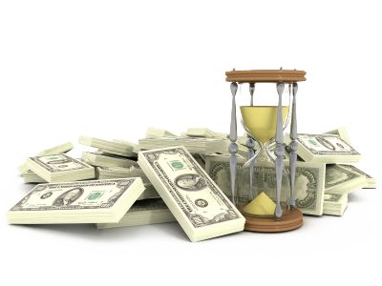
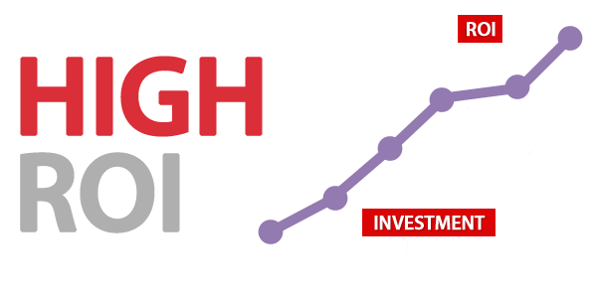


4.2 MOST FAMOUS ATTACKS – RUbixi
Ponzi Scheme, fraudulent investment program
Participants gain money from newcomers
Owner collects fees paid to the contract
Notes:
Let’s have a look at another attack: called RUBIXI
Rubixi is another game and it works as follows:
The game implements a so called ponzi scheme:
This scheme works as follows:
Just imagine: there is some kind of investment, for example a hedge fund
The owner of the scheme guarantees (GARANTIES) you, that if you would invest your money you would be have a very very high RETURN OF INVESTMENT (such like 50%). Therefore you invest your money
At the beginning, the scheme’s owner will keep his promise and he will return you your invested money
Indoing so, you will invest again, with a greater amount of money and you will tell your friend how much profitable (PROFITABLE) it is.
As a consequence, a lot of people will invest in this fraudulent scheme
The money invested from the newcomers, will be used to pay the fee of the participants
As soon as the owner reaches a big amount of money, he will escape the game keeping the money

Slide 32

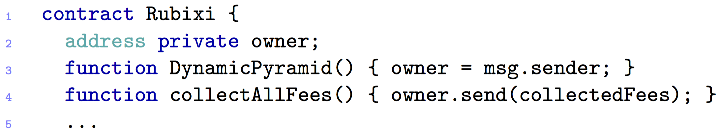
4.2 MOST FAMOUS ATTACKS – RUbixi
Financial
Notes:
So now please have a look at the contract by your own. Do see anything wrong with it?
At some point during the development of the contract, its name was changed from DynamicPyramid into Rubixi.
Programmers forgot to change the name of the constructor, which then became a function invokable by anyone
After this bug became public, users started to invoke DynamicPyramid in order to become the owner, and so to withdraw the fees.

Slide 33
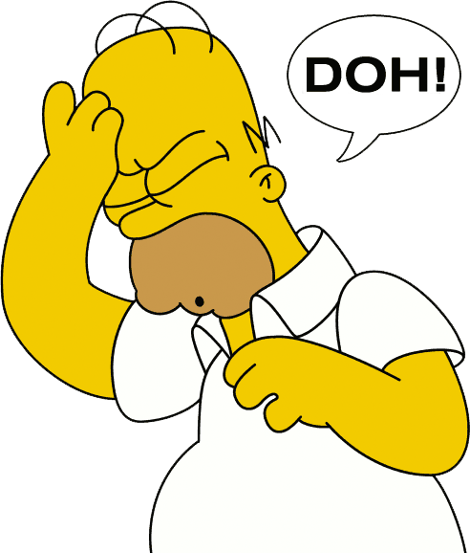
4.2 MOST FAMOUS ATTACKS – Rubixi– POSSIBLE SOLUTIONS
Change the constructor’s name ☺

Slide 34
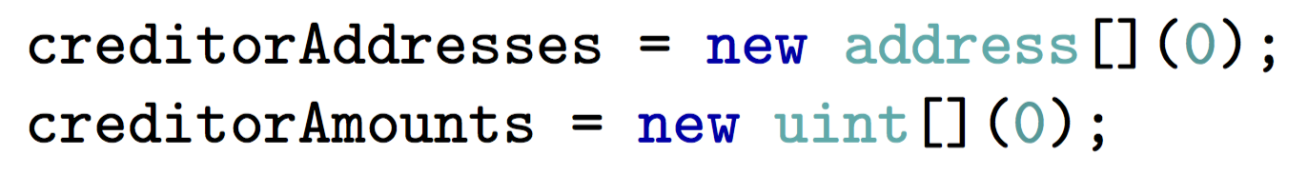
4.2 MOST FAMOUS ATTACKS – Govern-Mental
Ponzi Scheme
To join the scheme, participant must pay a fee
12 hours
Two arrays: list of participants and their credit
After 12 hours:
Notes:
The Governmental attack is based on the ponzi scheme.
To join it, a participant must send a certain amount of ether to the contract
And if nobody joins the scheme for 12 hours, the last participant will get all the ether in the contract, except for a small fee that is kept by the owner of the contract
¨When the 12 hours are expired, the two array are simply cleared as follows:

Slide 35
4.2 MOST FAMOUS ATTACKS – Govern-Mental
…
List grew too long!
Required gas for cleaning the arrays, exceeds the maximum allowed for a single transaction
Notes:
One problem was that the list (array) grew too much and the amount of gas required to execute the function to clear them, exceeded the maximum allowed for a single transaction

Slide 36
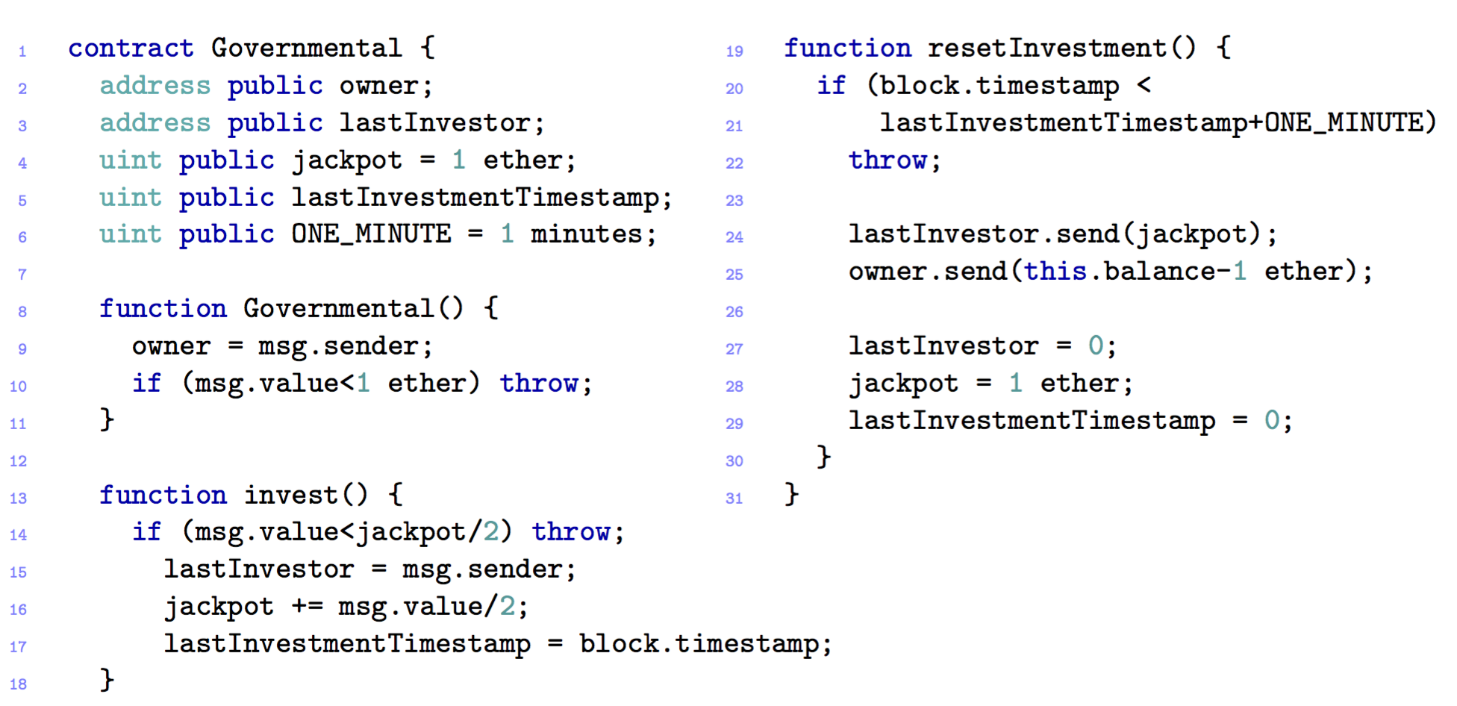
4.2 MOST FAMOUS ATTACKS – Govern-Mental
Notes:
Now let’s have a look at the code
To join the scheme, a player must invest at least half of the jackpot (line 14), otherwise it will throw an exception
Anyone can invoke resetInvestment
To make this contract easier to understand the timestamp the interval is set to ONE_MINUTE instead of 12 Hours
This function pays the jackpot (half of the invested total) to the winner (line 24), and sends the remaining ether to the contract owner.

Slide 37
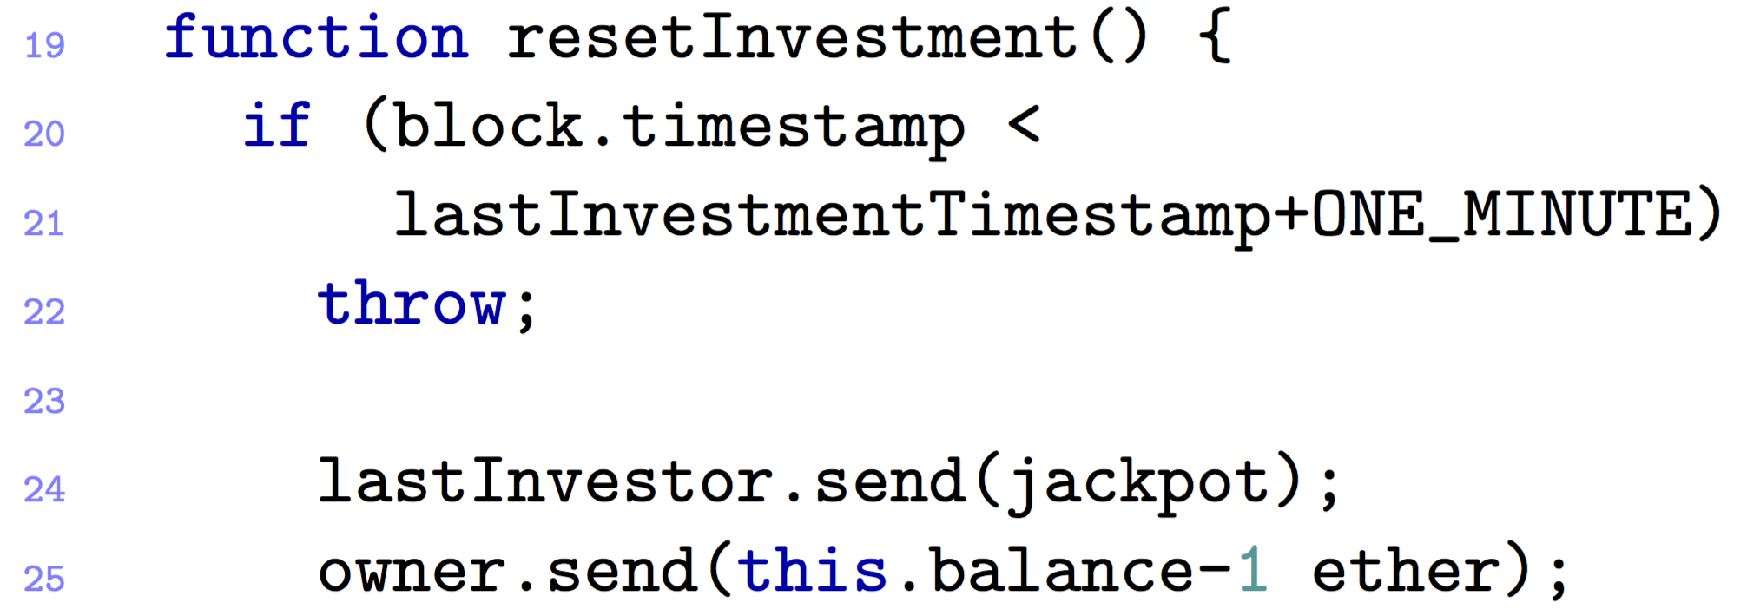

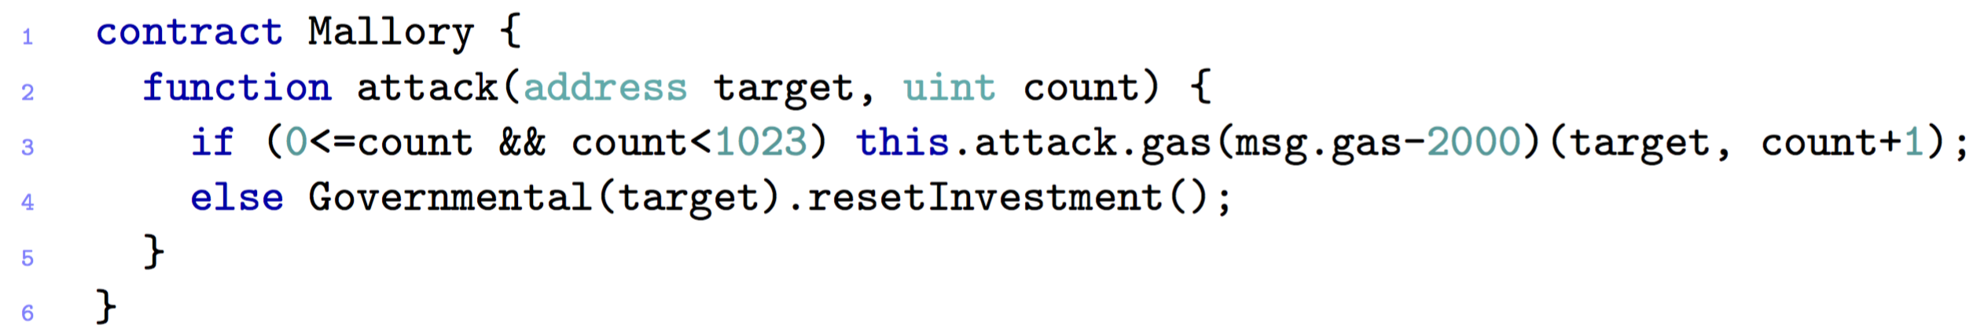
4.2 MOST FAMOUS ATTACKS – Govern-Mental
Must be performed by the owner
Goal: not to pay the winner
Notes:
The ATTACK works like this:
First of all it must be Performed by the owner of the contract
And His goal is not to pay the winner, so that the ether is kept by the contract,
To fulfil this goal, the owner has to make the send at line 24 fail.
The first thing to do is to is to publish a Mallory contract as follows:
RETTANGOLO -->Mallory starts invoking herself recursively (RECORSIVLY), making the stack grow
After 1022 function calls, the else statement is executed with resetInvestment().
The send at line 24 fails -> which means that the stack limit is reached
Since GovernMental does not check the return code of send (LINE 24), the execution proceeds, resetting the contract state and starting another round
The balance of the contract increases every time this attack is run, because the legit winner is not paid. To collect the ether, the owner only needs to wait for another round to terminate correctly.

Slide 38
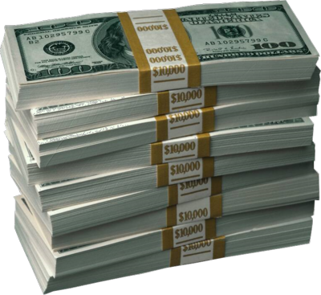
4.2 MOST FAMOUS ATTACKS – Govern-Mental– POSSIBLE SOLUTIONS
Increase cost of external function
Notes:
The vulnerability which has been used is the “stack size limits”. This vulnerability has been fixed ->
By increasing the cost of the call of external function so that it is impossible to fill the stack:
any attempt will cause an out-of-gas exception.
This makes the attack no longer possible.

Slide 39
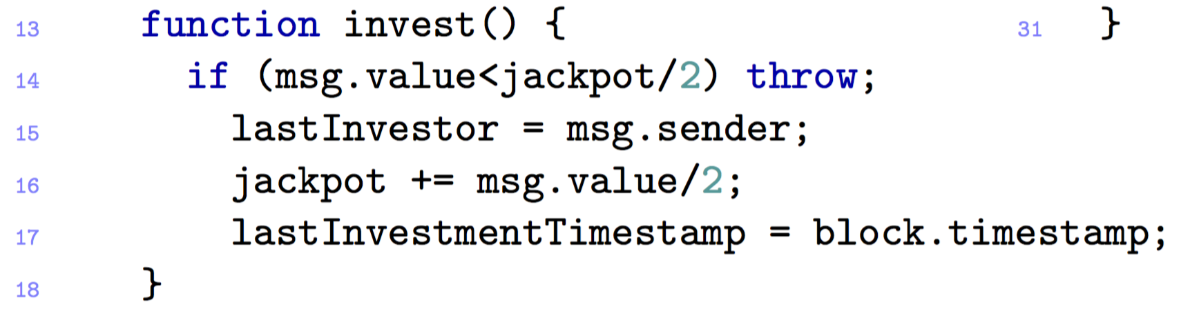
4.2 MOST FAMOUS ATTACKS – Govern-Mental - #2
Attacker does not include in blocks the transactions in order to be the last player
Notes:
Another ATTACK is performed this time by a miner and not the contract owner
By being a miner, he can choose not to include in blocks the transactions directed to GovernMental, except for her own, in order to be the last player in the round.
the attacker can reorder the transactions, such that her one will appear first

Slide 40
4.2 MOST FAMOUS ATTACKS – Govern-Mental - #3
The miner alters the timestamps
She manages to publish the new block with the delayed timestamp
She will be the last player and win the jackpot
Notes:
Also in this case the attacker is a miner impersonating a player.
Assume that the attacker manages to join the scheme. To be the last player in a round for a minute, she can play with the block timestamp.
More specifically, the attacker sets the timestamp of the new block so that it is at least one minute later the timestamp of the current block.
As discussed along with the “time constraints” vulnerability, there is a tolerance on the choice of the timestamp.
If the attacker manages to publish the new block with the delayed timestamp, she will be the last player in the round, and will win the jackpot.

Slide 41
4.2 MOST FAMOUS ATTACKS – Govern-Mental– Vulnerabilities
Stack size limits
Unpredictable state
Time constraints
Notes:
The following vulnerabilities were exploited in these attacks:
Stack size limits for the first attack
Unpredictable state for the second one
And time constraints for the last one

Slide 42
5.1 OPEN Challenges in Smart Contract
No guarantee of transaction execution
No contractual obligation for miners
Turing-complete smart contracts are slow
contracts can only be executed in sequential order
Oracles break the trust model
Centralized decentralization
Notes:
There is no contractual obligation that says a miner must include your transaction in a block. You could for example attach a high fee with your transaction, but it might still be ignored by miners for other reasons.
Consider a simple calculator with a balance of 50. If two incoming transactions tell the calculator to divide by 10 and subtract 3, the result is 2. However, the order must be guaranteed for obtaining a correct result. As you can imagine, contracts can only be executed in sequential order. If a node is unable to complete its transactions before the next block arrives, it fails.
There is a Trade-Off: smart contracts makes slow blockchains.
The more computations a Smart Contract needs, the more the blockchain will be delayed
3. The entities which provide the data for the smart contracts are so called oracles (for example data for an election result). BUT How far can we trust this oracle? Event though the miners, who convalidate the transactions can be trusted, who says me that the oracle can be also trusted? If the oracle has bed intentions, the whole model breaks down !
4. Even though the blockchain shuold work on a decentralized model, it is slowly moving towards a centralized execution. For example, in China were the the electricity cost is low there are more miners, which means that there is always more the risk that the blockchain becomes more centralized and that few people controls the transaction's bussiness.
Another example today, 80% of Bitcoin’s network stays in one country.

Slide 43
5.1 EtherEum Challenges in Smart Contract
Improve Solidity
Documentation is divided across the network and not easily accessible
Trust is a must
Notes:
Improve solidity to make it more intuitiv for the developers.
Another major cause (COS) of the proliferation of insecure smart contracts is that the documentation of known vulnerabilities is is shredded across the network. A comprehensive, self-contained and updated sur- vey of vulnerabilities and attacks to Ethereum smart contracts is still lacking.
to append a new block of data to the blockchain, nodes must participate to a lottery, where the probability of winning is proportional to the computational power of the node. An incentive mechanism ensures that, even if a malicious node who wins the lottery tries to append a block with incorrect contract executions, this block will be eventually removed from the blockchain. Despite some criticism about the e↵ectiveness of the consensus protocol [37,44], recent theoretical studies establish its security whenever the honest nodes control the majority of the computational power of the network [39,52].

Slide 44

Questions?

Slide 45
Discussion – Smart contract Usability
Are there agreements that cannot be completely automatized, i.e. for which you cannot use a Smart Contract?
Can they completely replace traditional contracts?
Are Smart Contracts a really good solution ?
Notes:
Gli Smart Contract sono una soluzione concreta o possono sostituire completamente I contratti tradizionali?
Ci sono agreements che non possono essere automatizati?
Qual’è il vero incentivo che muove I Miners (verifier) nela validiation di un contratto? Possono essere spinti solo dal fee che ricevono?
Dal momento che la invulnaribialità al 100% di un contratto non è garantita, preferireste affidarvi a contratti tradizionali (soggetti a interessi propri) o a un contratto soggetto ad attacchi hacker?
L’immediatezza di un contratto (e quindi senza l’intervento umano) rappresenta un vantaggio sempre? Esempio automobile -> metti che hai dei problemi in famiglia e la macchina si blocca subito alla prima rata non pagata senza neanche richiedere il perchè non è stata pagata la rata

Slide 46
Discussion – Smart contract Security
If yes, in which cases would you prefer Smart Contract over traditional ones?
Would you be willing to rely on a Smart Contract?
Notes:
Neither by traditional contracts nor by Smart Contracts the invulnerability and the security are guaranteed.
DA DIRE A VOCE
Qual’è il vero incentivo che muove I Miners (verifier) nela validiation di un contratto? Possono essere spinti solo dal fee che ricevono?
Dal momento che la invulnaribialità al 100% di un contratto non è garantita, preferireste affidarvi a contratti tradizionali (soggetti a interessi propri) o a un contratto soggetto ad attacchi hacker?
L’immediatezza di un contratto (e quindi senza l’intervento umano) rappresenta un vantaggio sempre? Esempio automobile -> metti che hai dei problemi in famiglia e la macchina si blocca subito alla prima rata non pagata senza neanche richiedere il perchè non è stata pagata la rata

Slide 47
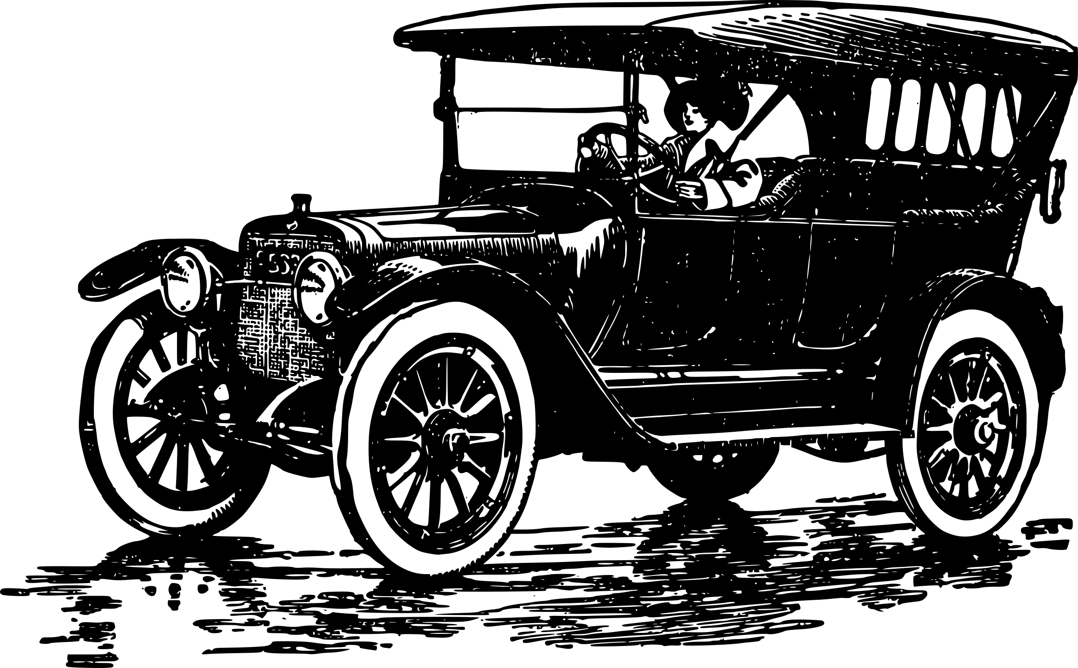
Discussion – Automobile Example
A Family leases a car with a company
The company stipulates a Smart Contract with the Family in order to automate the leasing process
The following conditions are given:
The engine and the main components of the car are controlled by the smart contract
The family has to pay the leasing fee at end of each month
Notes:
Which kind of problems can occur using a Smart Contract in this scenario?
Which ones would not occur if we were using a traditional contract?

Slide 48



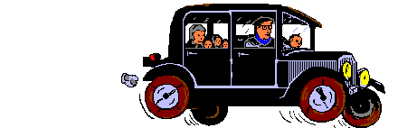
Discussion – Automobile Example
The brakes
do not
work!

